Slide 1

IzzyOnDroid Download Statistics
What they are, how they work and how to use them

Slide 2

Who am I
Sylvia van Os (aka: TheLastProject)
DevOps / System administrator
IzzyOnDroid contributor
Catima developer

Slide 3
Why download statistics?
Helps users choose the right app for them
  Prioritizes “popular” apps (for FOSS: mostly word of mouth)
  Prioritizes older well-maintained apps (update = download spike, age = total downloads)
Not a silver bullet
  Not a guarantee of quality, but an indicator
  Works best over medium periods (account for age but not solely)

Slide 4
General overview
Client downloads app from server
Server logs this
iod-stats-builder extracts privacy-friendly summary from server logs
Server operator publishes summary
iod-stats-collector downloads all known summaries and publishes a combined version
Clients use iod-stats-collector data to show download counts

Slide 5
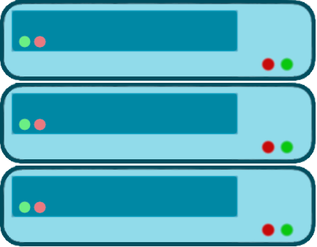





General overview
IzzyOnDroid
Mirrors
Statistics Server
Clients
Server Log
Basic
Upstream
iod-stats-builder
Index + stats (JSON)
iod-stats-collector

Slide 6
General overview
IzzyOnDroid
Mirrors
Statistics Server
Clients
Server Log
Basic
Upstream
iod-stats-builder
Index + stats (JSON)
iod-stats-collector

Slide 7
General overview
IzzyOnDroid
Mirrors
Statistics Server
Clients
Server Log
Basic
Upstream
iod-stats-builder
Index + stats (JSON)
iod-stats-collector

Slide 8
iod-stats-builder
Reads server logs and turns them into stats
Two Python files + TOML config file
Two phases

Slide 9
iod-stats-builder configuration
127.0.0.1 - [02/Mar/2025:00:39:27 +0100] "GET /fdroid/repo/org.fossify.gallery_9.apk HTTP/1.1" 200 44152923 4712760 "-" "F-Droid 1.17.0"
[parser]
type = 'regex'
regex = '(?P<ip>.*).* \S* \[(?P<datetime>.*)\] "(?P<method>\w*) (?P<path>\S*) \S*" (?P<statuscode>\d{3}) (?P<size>\S+) -?(?P<requesttime>\d+) "(?P<referer>.*)" "(?P<useragent>.*)"'
repo_prefix = '/fdroid/repo/'
app_suffix = '.apk'
datetime_format = '%d/%b/%Y:%H:%M:%S %z'

Slide 10
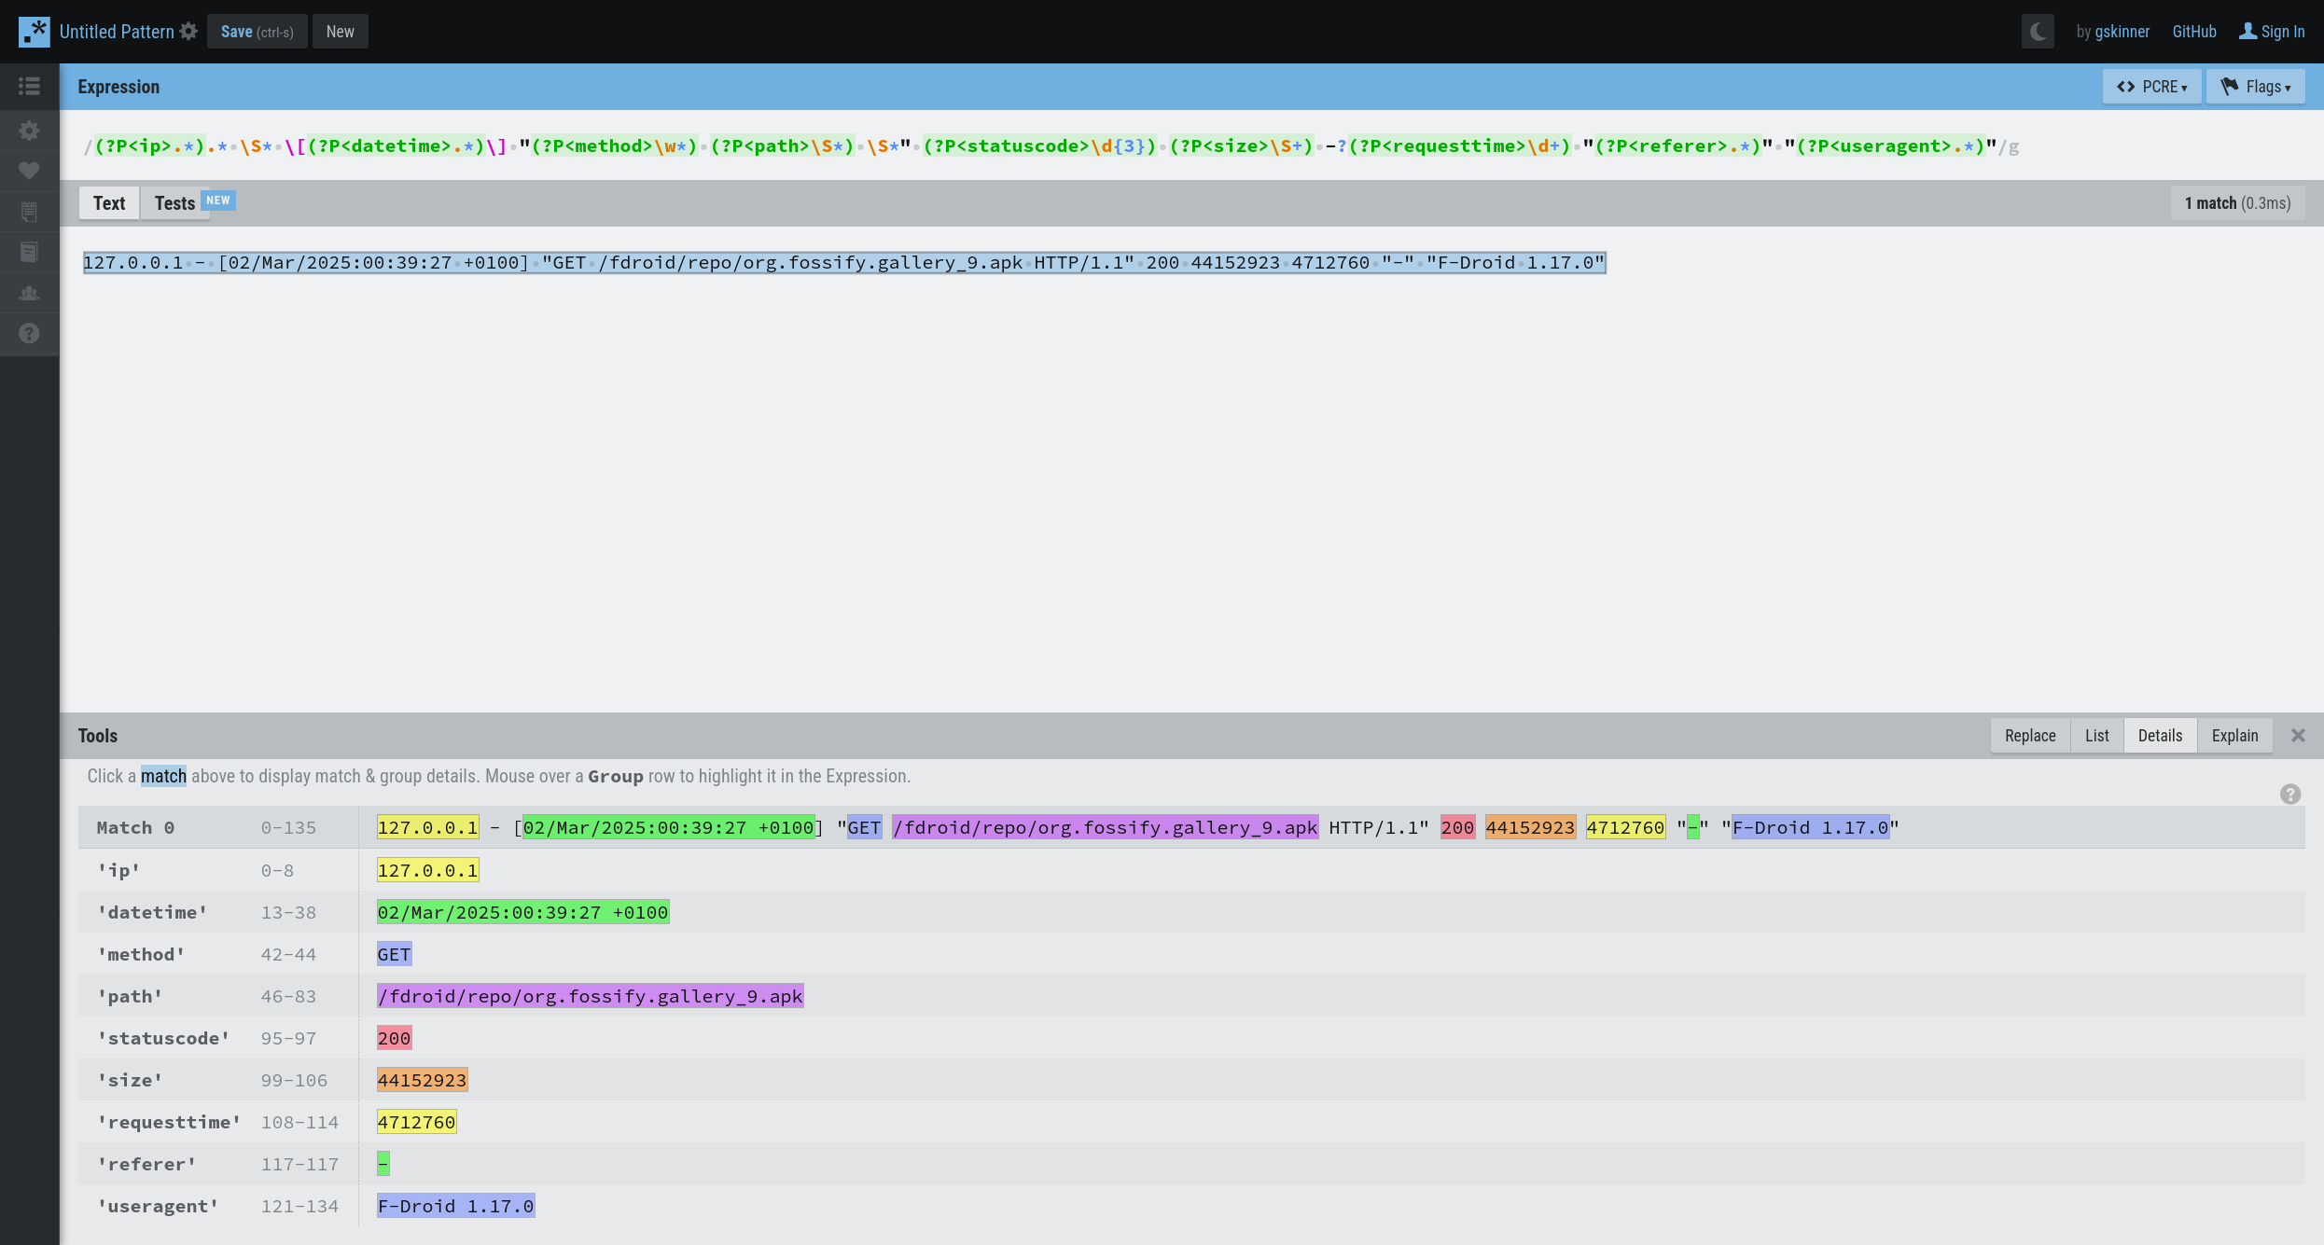

Slide 11
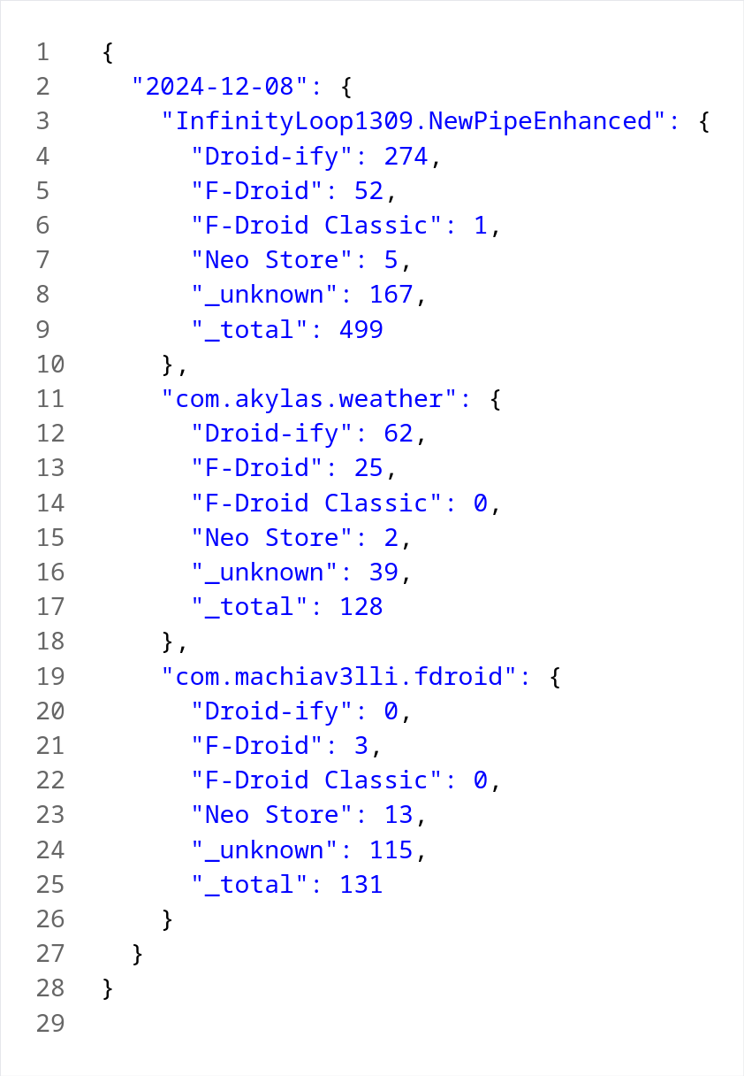
Stats generation example
Logs in /var/log/apache/access.log
Command:
cat /var/log/apache/access.log |
grep -E ‘\.apk .* 200’ |
python3 iod_dl_parser.py --config config.toml >
stats/$(date +%s).json

Slide 12
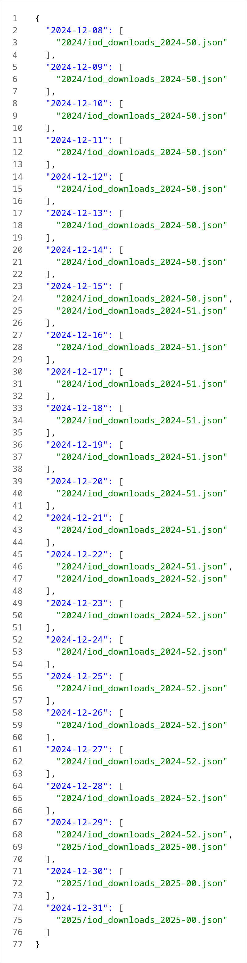
Index generation example
Stats in stats/
Command:
python3 iod_dl_index_generator.py --stats-dir stats/
Keep index.json and stats dir together!

Slide 13
iod-stats-builder gotchas
Regex has to match fully (partial matches are ignored)
Requires Python 3.11 (though can run on older using python3-pytoml)
Partial parse will be saved with exit code 2
No duplicate data detection

Slide 14
Downsides for consumers
Only contains data for one server
Very verbose, always per day
Requires reading index.json to find stats for a certain date

Slide 15
General overview
IzzyOnDroid
Mirrors
Statistics Server
Clients
Server Log
Basic
Upstream
iod-stats-builder
Index + stats (JSON)
iod-stats-collector

Slide 16
iod-stats-collector
Merges multiple sources
Creates easy to consume files
Updated daily on Codeberg using Woodpecker CI
Published to a public URL

Slide 17
Iod-stats-collector types
Basic: Per app download counts, no client info
Upstream: Per app download counts split per client (same format as iod-stats-builder)

Slide 18
Iod-stats-collector date types
Yearly: Total downloads over the whole year (rolling.json: last 365 days)
Monthly: Total downloads over the whole month (rolling.json: last 30 days)
Monthly-in-days: Day-separated downloads for a specific month (rolling.json: last 30 days)
Daily: Downloads for a specific day

Slide 19
Iod-stats-collector examples
Getting a very basic overview of the total number of downloads per app in the last 30 days: stats/basic/monthly/rolling.json
Getting per-day information of all downloads in June 2025 with the client information: stats/upstream/monthly/2025-06.json
Getting all downloaded apps on June 1st, 2025, without client info: stats/basic/daily/2025-06-01.json

Slide 20
General overview
IzzyOnDroid
Mirrors
Statistics Server
Clients
Server Log
Basic
Upstream
iod-stats-builder
Index + stats (JSON)
iod-stats-collector

Slide 21
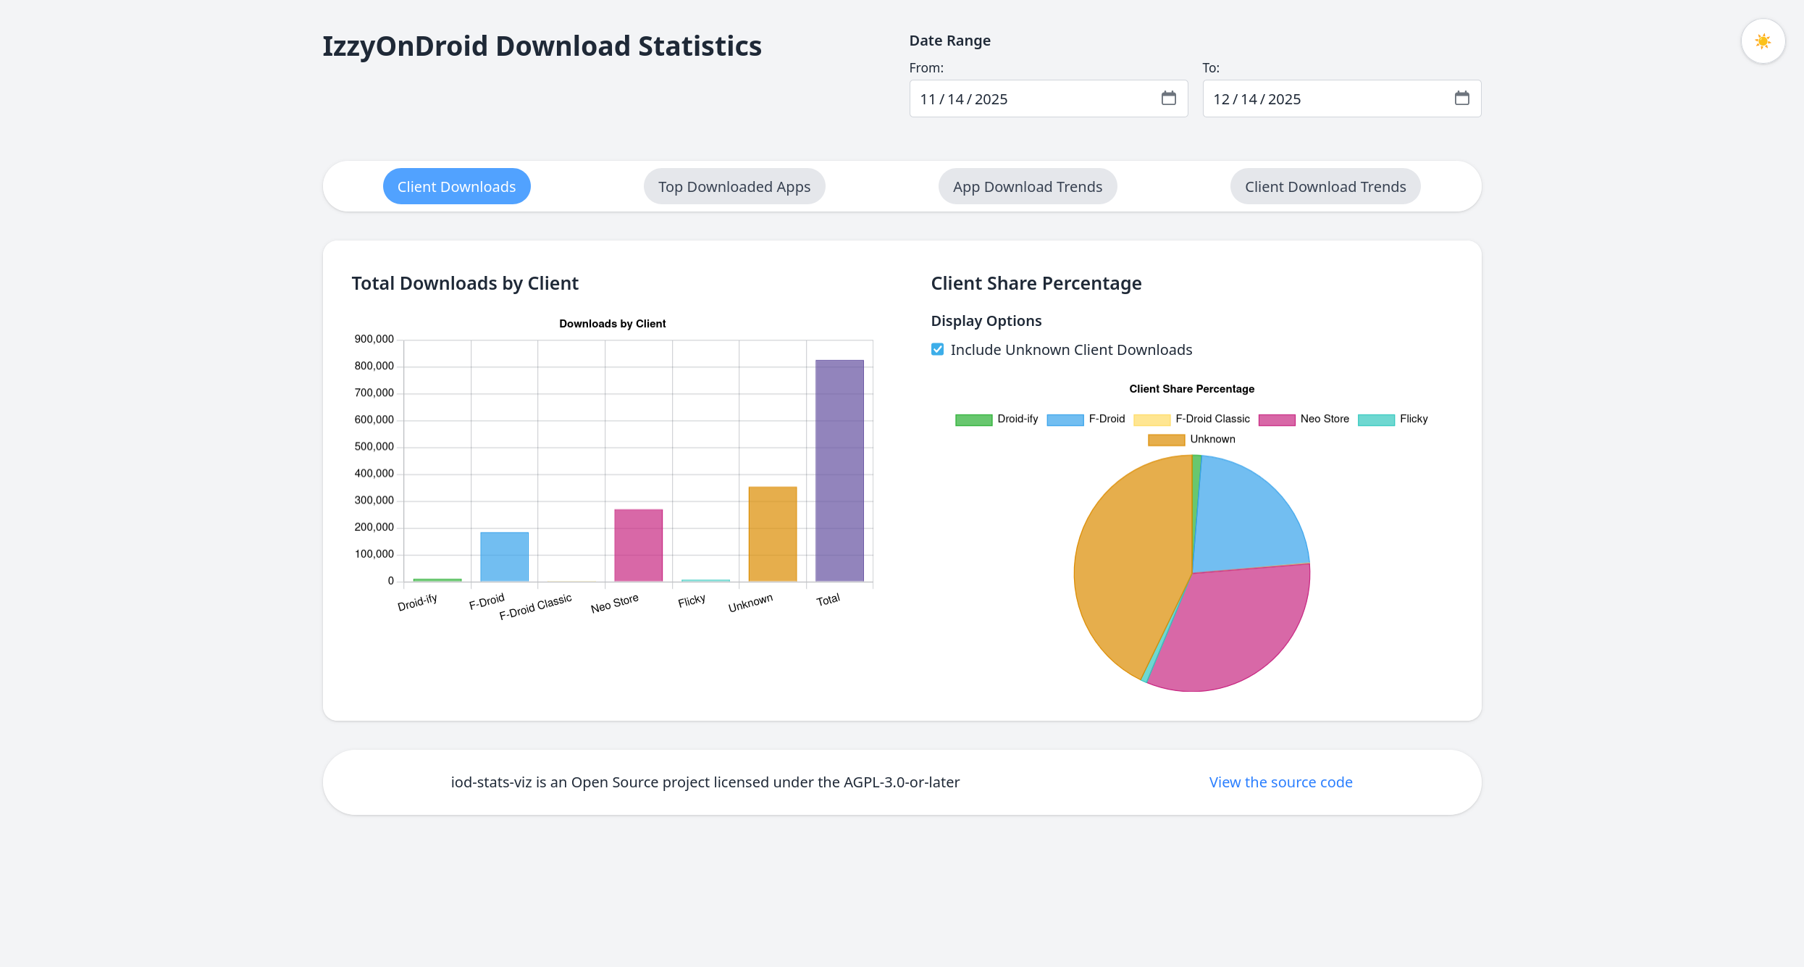
stats.izzyondroid.org

Slide 22
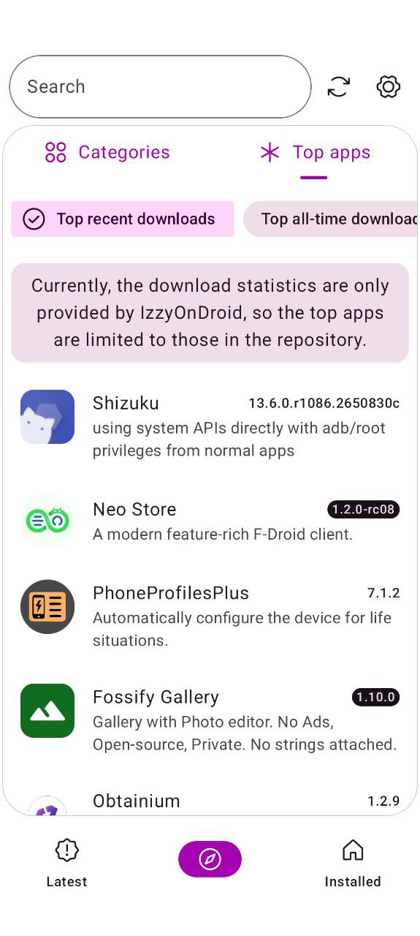
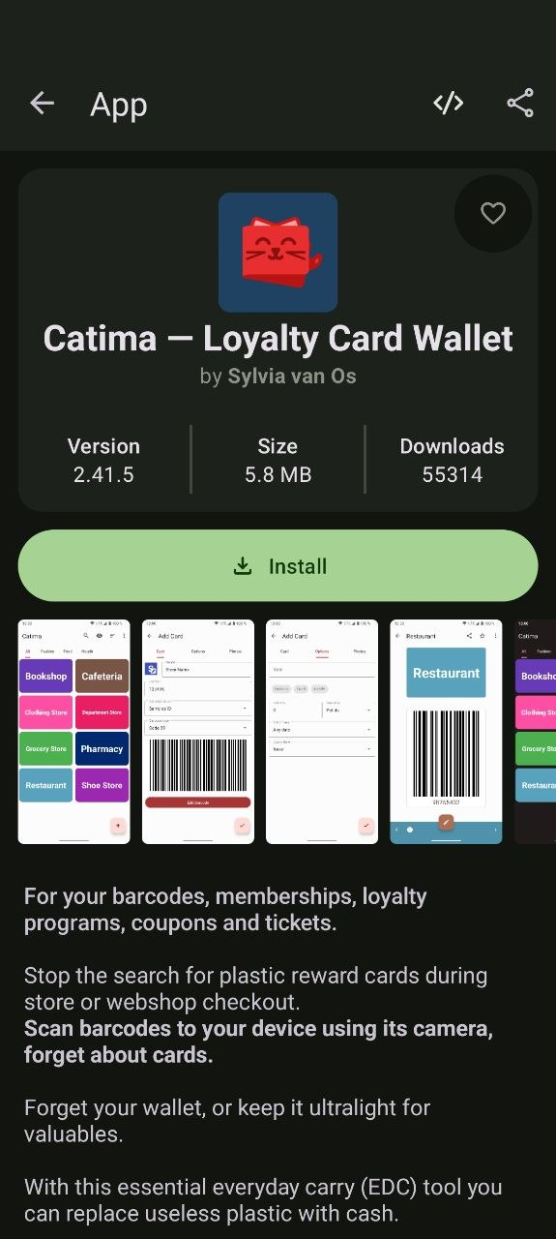
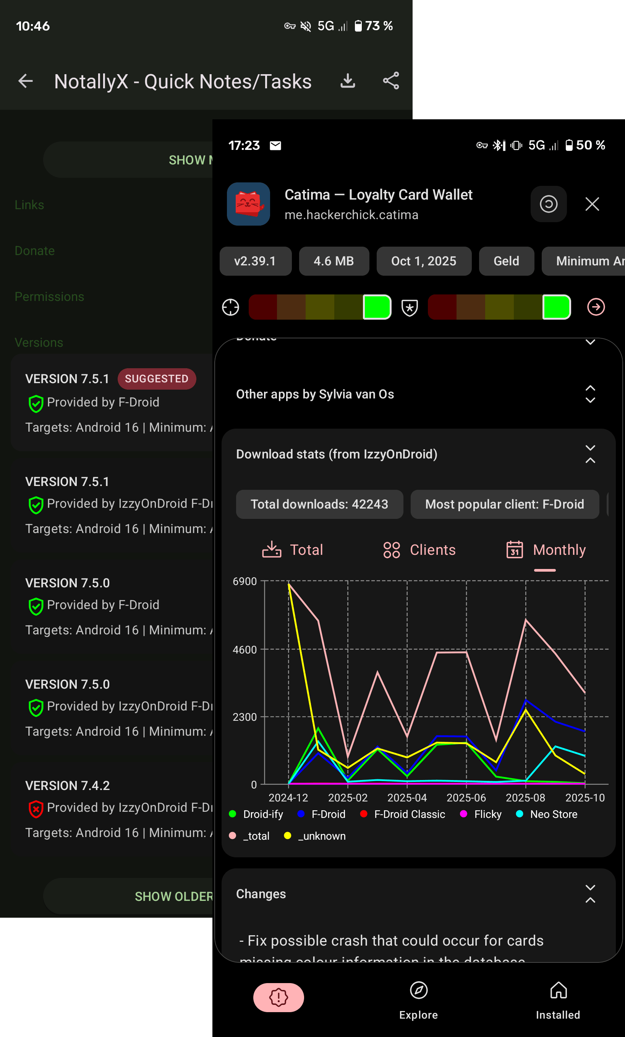
Droid-ify & Neo Store

Slide 23


Thank you!

Slide 24
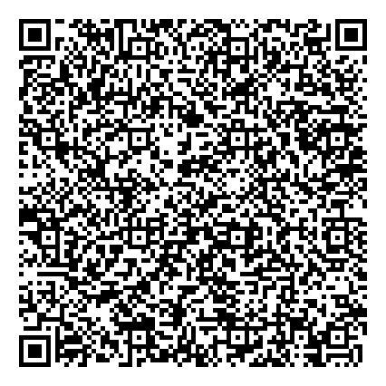
Important links
Download stats dashboard: https://stats.izzyondroid.org/
Neo Store: https://apt.izzysoft.de/fdroid/index/apk/com.machiav3lli.fdroid
iod-stats-builder: https://codeberg.org/IzzyOnDroid/iod-stats-builder/
iod-stats-collector: https://codeberg.org/IzzyOnDroid/iod-stats-collector/

